Slide 1
PAYROLL GENERATION SYSTEM
Introduction to the Java application for automating payroll generation

Slide 2
Our Team
Mohit Kumar
1000021153
Gaurav Garwal
1000021200
Riya Bharti
1000021443
Krishna Kant Singh
1000021294

Slide 3
About
The Payroll Application is a user-friendly software designed to simplify payroll management for businesses and organizations. Developed with Java and Swing, it provides a comprehensive solution for calculating employee salaries, including earnings, deductions, and net pay.

Slide 4
Problem Statement
Challenges faced by organizations in manual payroll processing.
Need for accuracy, efficiency, and security in payroll management.

Slide 5
Key Features
Efficient Salary Calculation
Earnings and Deductions
Net Salary Generation
User-Friendly Interface
Customization
Date Tracking
Currency Formatting

Slide 6
SOFTWARE ARCHITECTURE OVERVIEW
The Payroll Application follows a layered architecture, which separates the user interface, business logic, and data access layers. This architecture promotes modularity, scalability, and maintainability.
Presentation Layer: This layer comprises the graphical user interface (GUI) components developed using Java Swing. It interacts with the user, accepts input, and displays output.
Business Logic Layer: The business logic layer contains the core functionality of the application, including salary calculation, tax computation, and currency formatting. It ensures the integrity and accuracy of data processing.
Data Access Layer: This layer manages the interaction with external data sources, such as files or databases. In the Payroll Application, data access is minimal, as it primarily deals with user input and internal calculations.

Slide 7
DESIGN PRINCIPLES
Single Responsibility Principle (SRP): Each module within the application is designed to have a single responsibility, ensuring clarity and maintainability of the codebase.
Modularity: The application is divided into cohesive modules, allowing for independent development, testing, and maintenance of each component.
Encapsulation: Data and behavior are encapsulated within classes, reducing dependencies and promoting code reusability.
Abstraction: The application abstracts complex operations, such as salary calculation and tax computation, into reusable functions and methods, enhancing readability and maintainability.

Slide 8
COMPONENTS AND MODULES:
User Interface Components: These include labels, text fields, buttons, and separators used for inputting employee data and displaying salary information.
Business Logic Modules:
Salary Calculation Module: Computes gross salary, allowances, deductions, and net salary based on user input.
Tax Computation Module: Calculates income tax based on gross salary and applicable tax rates.
Currency Formatting Module: Formats numerical values into currency strings using the Indian locale.
Data Access Module: Although minimal, this module manages interactions with external data sources, such as retrieving and updating employee information.
Utility Modules:
String Formatting Module: Converts text input into proper case format for consistency.
Date Formatting Module: Generates the current date in the desired format for display.

Slide 9
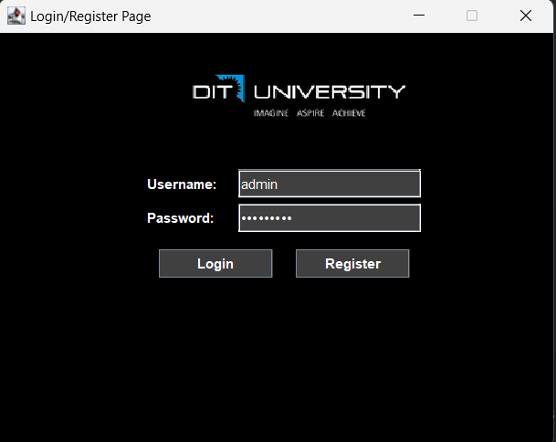
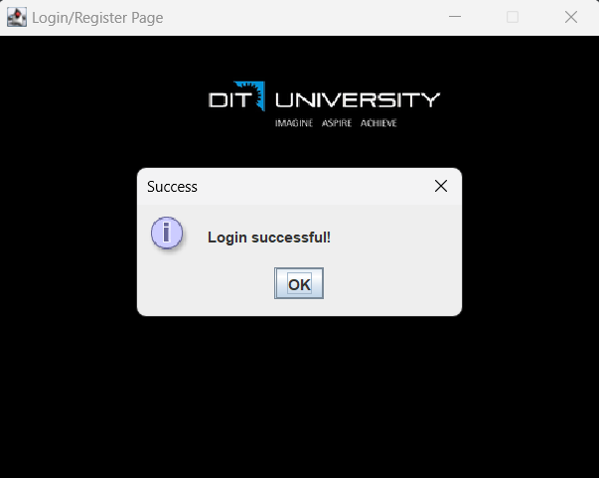
DEMO

Slide 10
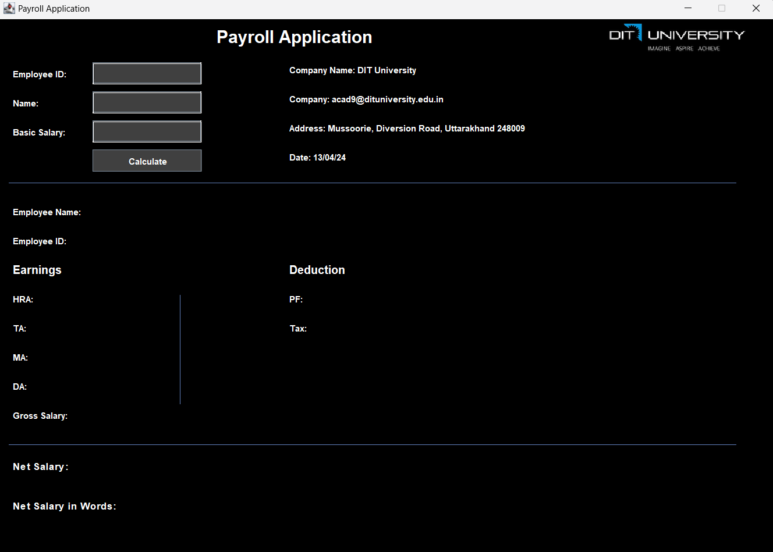
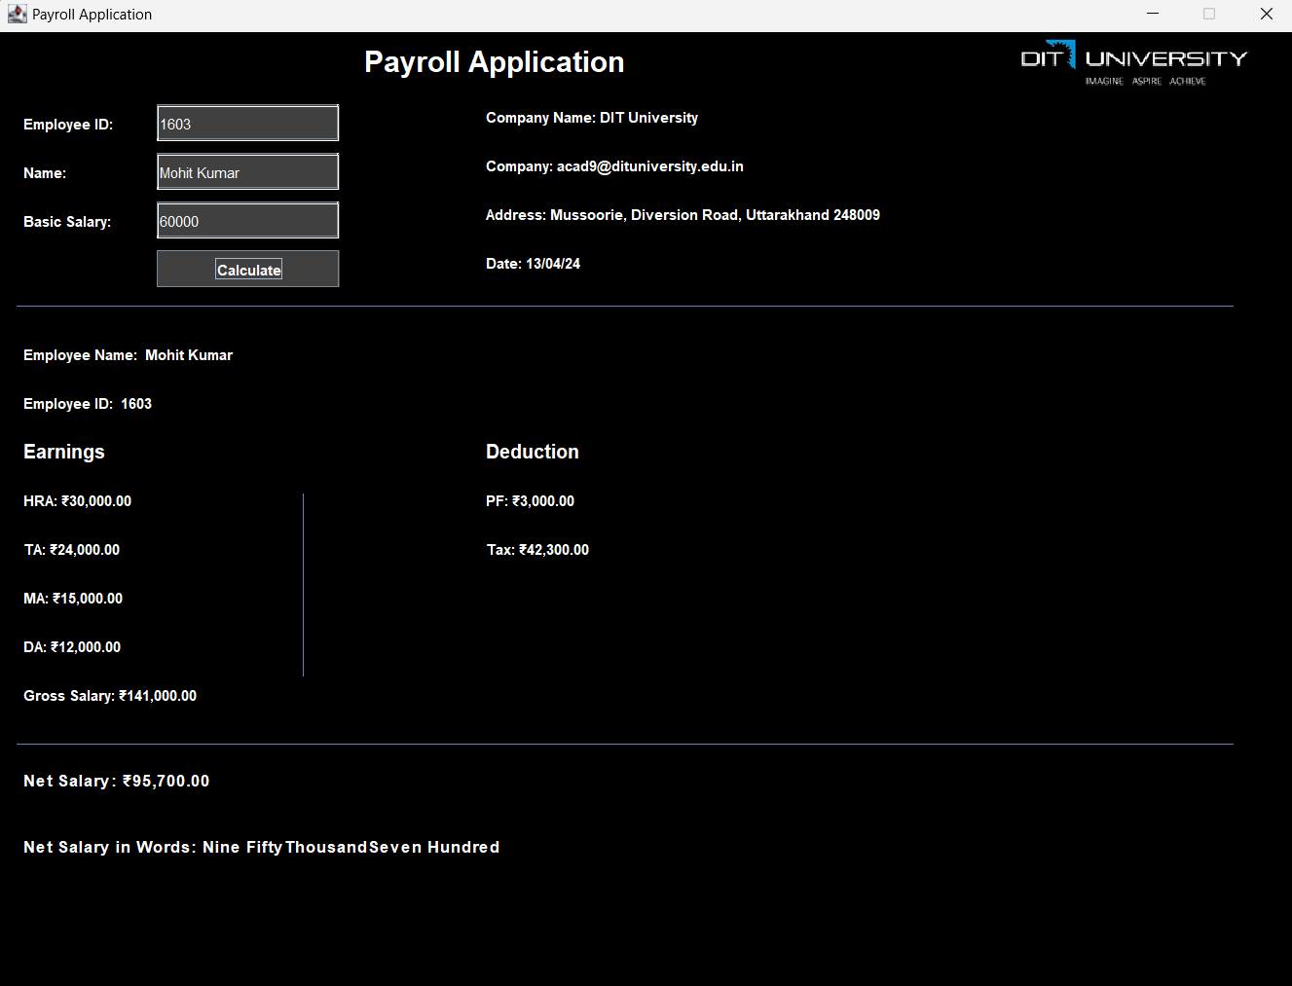
Demo Cont..

Slide 11
Steps to Run the Software
Setup Development Environment:​
Ensure you have Java Development Kit (JDK) installed on your system. You can download and install it from the official Oracle website or use OpenJDK.​
Set up a Java IDE (Integrated Development Environment) such as IntelliJ IDEA, Eclipse, or NetBeans for easier development. Alternatively, you can use a text editor like Visual Studio Code.​
Download Source Code:​
Download the source code files for the Payroll Application, including all Java files and any additional resources like images or configuration files.​
Import Project:​
Open your Java IDE and import the downloaded project into the IDE workspace. This step may vary depending on your IDE. Generally, you can find an option like "Open Project" or "Import Project" in the File menu.​
Resolve Dependencies:​
Ensure that all necessary dependencies, such as Java Swing libraries, are correctly configured in your project. If any dependencies are missing, you may need to add them manually.​

Slide 12
Cont...
Compile the Code:
Compile all Java source files to generate the corresponding bytecode. Most IDEs provide options to compile the entire project with a single command.
Set Logo (Optional):
If the application uses a logo or any external resources, make sure they are correctly referenced in the code. Ensure that the path to the logo file is accurate and that the file exists in the specified location.
Run the Application:
Once the project is successfully compiled without any errors, you can run the application. Locate the main Java file (usually named PayrollApplicationGUI.java) that contains the main() method.
Right-click on the main file and select the option to run it. Alternatively, you can use the "Run" button provided by your IDE.
Provide Input:
After running the application, a graphical user interface (GUI) window should appear on your screen. The interface typically includes input fields for Employee ID, Name, and Basic Salary, along with a "Calculate" button.

Slide 13
Cont..
Enter Employee Details:
Enter the required details such as Employee ID, Name, and Basic Salary into the respective input fields.
Calculate Salary:
Click on the "Calculate" button to compute the employee's salary based on the provided input. The application will perform calculations for various components such as Gross Salary, Tax, Deductions, and Net Salary.
View Results:
The application will display the computed salary details, including Gross Salary, Tax, Deductions, Net Salary, and the Net Salary amount in words.
Exit the Application:
Once you have finished testing the application, close the GUI window to exit the application. Alternatively, you can use any exit buttons provided within the interface.

Slide 14
BENEFITS
Time-Saving: By automating salary calculations, the application saves time for HR personnel and accounting professionals, allowing them to focus on other critical tasks.
Accuracy: With built-in algorithms for salary computation, the application minimizes errors and ensures accurate payroll processing.
Transparency: Employees can access detailed salary breakdowns, promoting transparency and trust within the organization.

Slide 15
FUTURE ENHANCEMENTS
Employee Database Integration
User Authentication and Authorization
Advanced Salary Components
Customizable Tax Rules
Reporting and Analytics

Slide 16
Refrences
Textbooks:
"Java: A Beginner's Guide" by Herbert Schildt.
"Head First Java" by Kathy Sierra and Bert Bates.
Database Management Systems" by Raghu Ramakrishnan and Johannes Gehrke.
Software Architecture in Practice" by Len Bass, Paul Clements, and Rick Kazman.
Online Resources:
Oracle Java Documentation: Official documentation for Java programming language.
Stack Overflow: Community-driven question and answer website for programming-related queries.
GitHub: Source code repository hosting service, where developers share and collaborate on projects.
Courses and Tutorials:
Online Java courses on platforms like Udemy, Coursera, and Codecademy.
Database management courses covering SQL and database design.
Software architecture and design courses focusing on principles and best practices.
APIs and Frameworks:
Java Swing documentation for building graphical user interfaces.
Java NumberFormat and DateFormat classes for formatting numbers and dates.

Slide 17

Thank You

